Slide 1
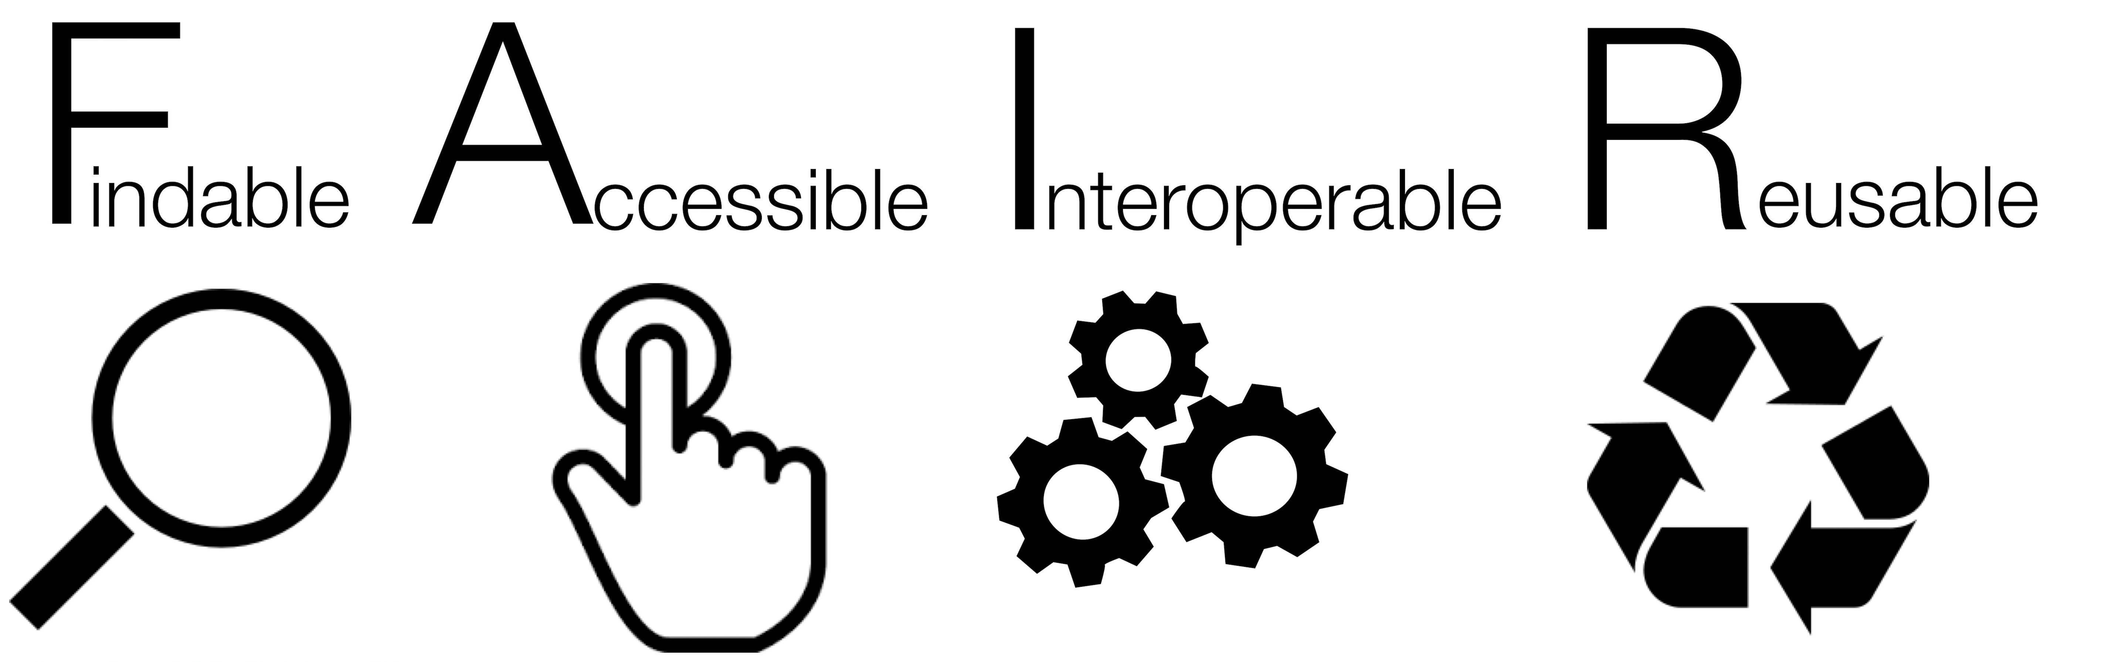
https://www.nature.com/articles/sdata201618

Slide 2


Why make your data FAIR?
Make your life easier
Improve your reputation
Meet funder requirements
Practice reproducible science
Support the common good
http://worldartsme.com/

Slide 3
To be Findable:
F1. (meta)data are assigned a globally unique and persistent identifier
F2. data are described with rich metadata (defined by R1 below)
F3. metadata clearly and explicitly include the identifier of the data it describes
F4. (meta)data are registered or indexed in a searchable resource

Slide 4
To be Accessible:
A1. (meta)data are retrievable by their identifier using a standardized communications protocol
A1.1 the protocol is open, free, and universally implementable
A1.2 the protocol allows for an authentication and authorization procedure, where necessary
A2. metadata are accessible, even when the data are no longer available

Slide 5
To be Interoperable:
I1. (meta)data use a formal, accessible, shared, and broadly applicable language for knowledge representation.
I2. (meta)data use vocabularies that follow FAIR principles
I3. (meta)data include qualified references to other (meta)data

Slide 6
To be Reusable:
R1. meta(data) are richly described with a plurality of accurate and relevant attributes
R1.1. (meta)data are released with a clear and accessible data usage license
R1.2. (meta)data are associated with detailed provenance
R1.3. (meta)data meet domain-relevant community standards

Slide 7
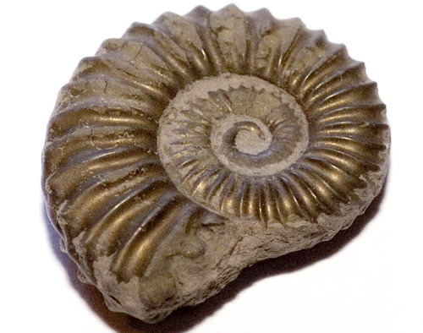

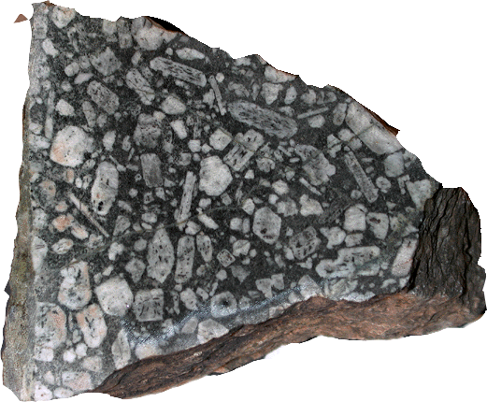
Building an "Internet of Samples"
specimens have permanent, unique, resolvable identifiers
those identifiers must be reused in derived data
metadata links different nodes in the graph

Slide 8
What can you do to make your data FAIR?

Slide 9
Learn about data management
Ten simple rules for creating a good data management plan:
https://journals.plos.org/ploscompbiol/article?id=10.1371/journal.pcbi.1004525
Use https://dmptool.org/
Use spreadsheets appropriately:
https://www.tandfonline.com/doi/full/10.1080/00031305.2017.1375989
Check out Data Carpentry:
https://datacarpentry.org/
and DataONE:
https://www.dataone.org/best-practices
Best practices for scientific computing:
https://journals.plos.org/plosbiology/article?id=10.1371/journal.pbio.1001745

Slide 10
Understand the data life cycle

Slide 11
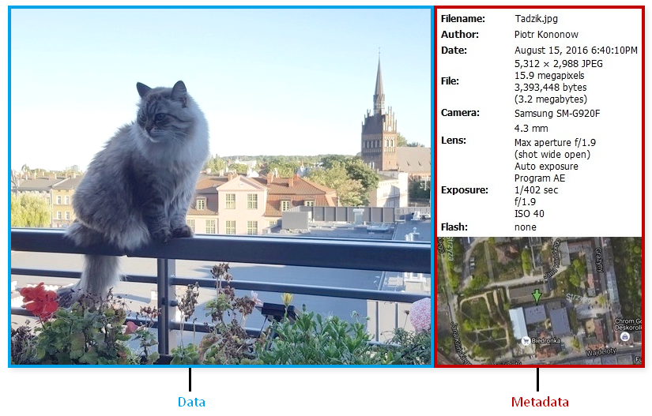
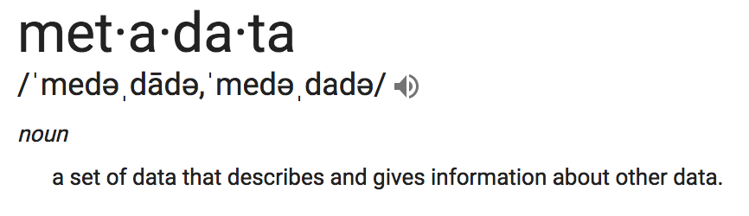
Use metadata

Slide 12
Follow best practices for data organization
Folder and file naming conventions are useful, but restrictive
Metadata can be used to subset data as needed
Avoid unnecessarily deep hierarchies
Write down rules for organizing and naming data
Have a strategy for version control
Avoid special characters and spaces
See: https://guides.library.upenn.edu/datamgmt/fileorg

Slide 13
Practice reproducible science
Record metadata at the same time you collect data (not when you are ready to publish)
Keep track of workflows and data provenance
Create a data dictionary
Use non-proprietary data formats
Publish your data in an open repository
Example dataset with metadata: https://datacommons.cyverse.org/browse/iplant/home/shared/commons_repo/curated/Bertioli_Arachis_genome_supplement_TVDM_Mar2019

Slide 14



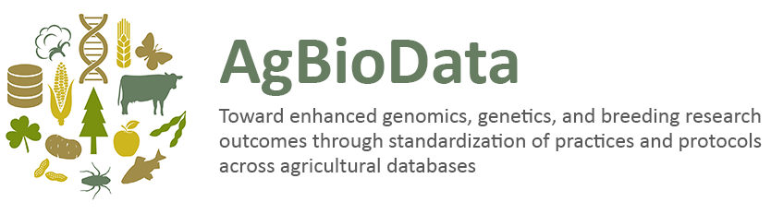
Data publication resources
https://www.nature.com/sdata/policies/repositories

Slide 15
Data Management Plans
DMP is: a formal document that outlines how data are to be handled during a research project and after the project is completed.
Goal: to consider the many aspects of data management, metadata generation, data preservation, and analysis before the project begins
Outcome: well-managed data in the present, data prepared for preservation and reuse in the future.
Resources: https://dmptool.org/general_guidance

Slide 16
Exercise: Create a DMP
Login to Uaccess
Go to https://dmptool.org/ and login with UA credentials
Create a new DMP using either the NIH template or the NSF BIO template. At least complete the description of your data types. You may want to discuss other aspects with your mentor.

